Slide 1
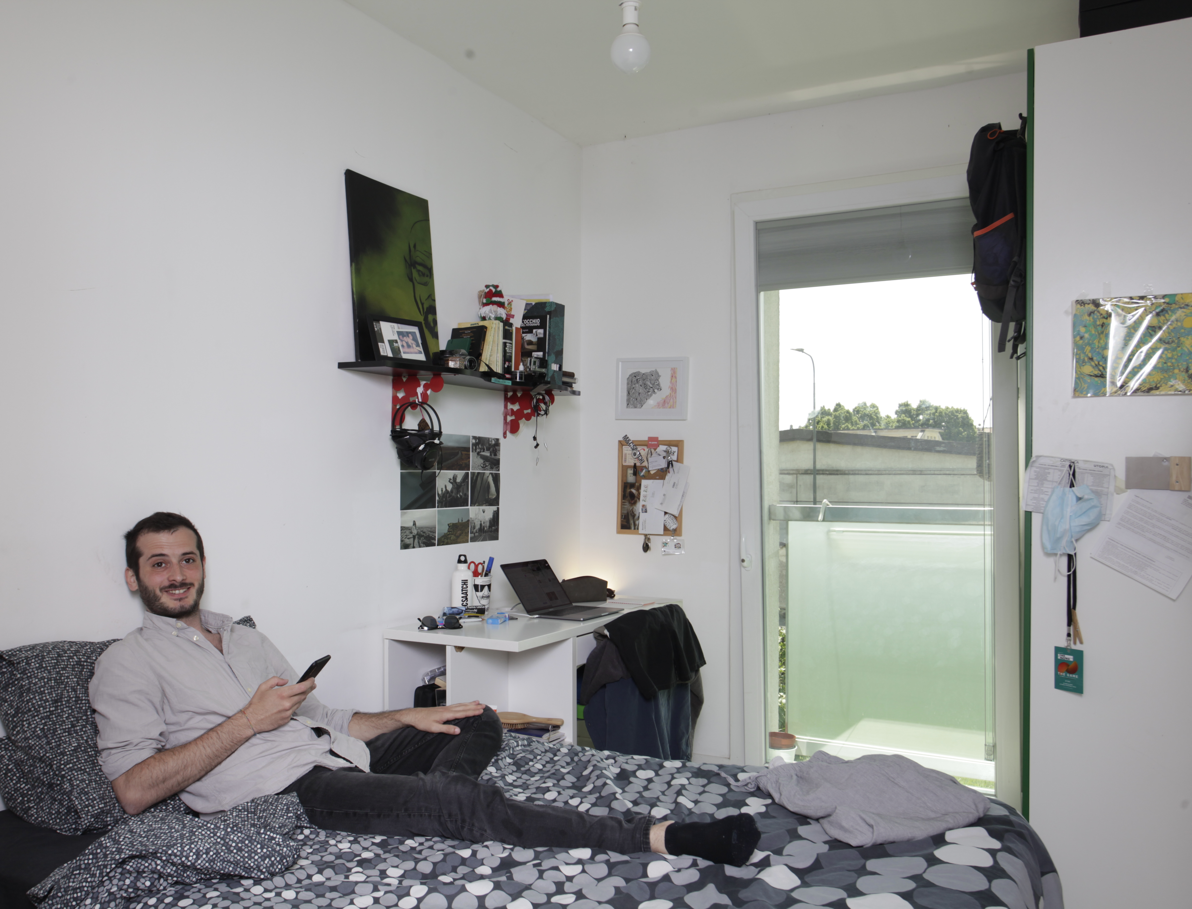


HOUSING POLICY AT EU LEVEL,
BEST PRACTICES & EXPERIENCES
Diana Yordanova
Communications Director
Housing Europe
Thessaloniki I 20 October 2023

Slide 2

THE RICHNESS OF THE HOUSING EUROPE NETWORK
43,000 local housing organisations
31 countries
+25 million dwellings
+/- 200,000 new dwellings per year
+/- 200,000 dwellings refurbished per year
€40bn in new investment per year
7,500+ staff employed by the federations
300,000+ staff employed by local providers
One goal - provide decent & affordable housing for all

Slide 3
1/3 OF THE NET INCOME SPENT FOR RENT IS OFTEN OUT OF REACH
Source: Housing Europe calculations, based on ISRP and Numbeo.
Notes:
Figure 4 outlines the relationship between private rental and net earnings for our hypothetical two earner couple.
In this case, we assume that one earner is at the average net income, while the second is at two-thirds of the average. Thus, the couple are still not a ‘low-income’ household by local standards. What we can see is that when a second income earner is added, the affordability situation improves. Indeed, while no city fell below the 30% threshold for a single-earner renting a one-bedroom apartment, a number of cities meet this affordability standard for the two-earner household. However, the differences between cities remains stark.
While the couple will pay less than 20% of their net income for a one-bedroom apartment in Bonn or Lyon, in Lisbon or Athens they are close to, or even above, the 60% mark. When it comes to a two-bedroom property, only a small fraction of cities fall below the 30% level of required net income. Again, we must emphasise that the twoincome household in this scenario is not low-income, and yet privately renting a home is clearly an issue for them in most instances.
Thus, those with less means will feel the economic strain linked to housing themselves more acutely, or else will be left in the situation that living in the city is simply not an option. This can see them forced to give up employment or educational opportunities, strain family or community ties, and reinforce the so-called ‘insider’ versus ‘outsider’ problem, by which those not already living in a city are prevented from accessing the various opportunities that may be available there. This is bad not only for the individual households concerned, but also for the wider society. Indeed, as noted by the OECD in a recent Working Paper: “Moving matters. The ease of moving residence geographically has efficiency implications because it affects the job-matching process: low rates of residential mobility can be an obstacle to labour adjustment, making labour markets less efficient, with adverse effects on overall economic performance” iii .

Slide 4
THE YOUNG PEOPLE OF TODAY ARE WORRIED ABOUT BECOMING ADULTS
Source: Housing Europe calculations, based on ISRP and Numbeo.

Slide 5
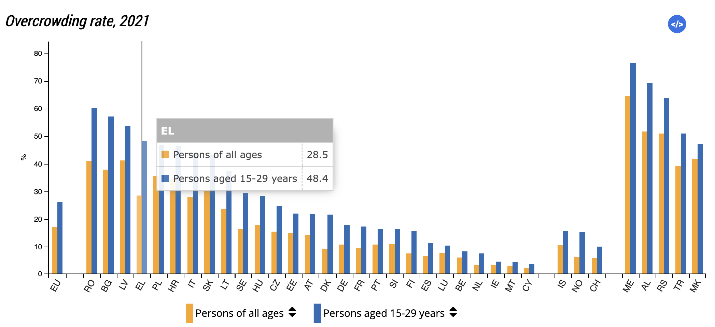
OVERCROWDED HOMES WHILE HOUSING NEEDS OF YOUTH HAVE EVOLVED MASSIVELY

Slide 6
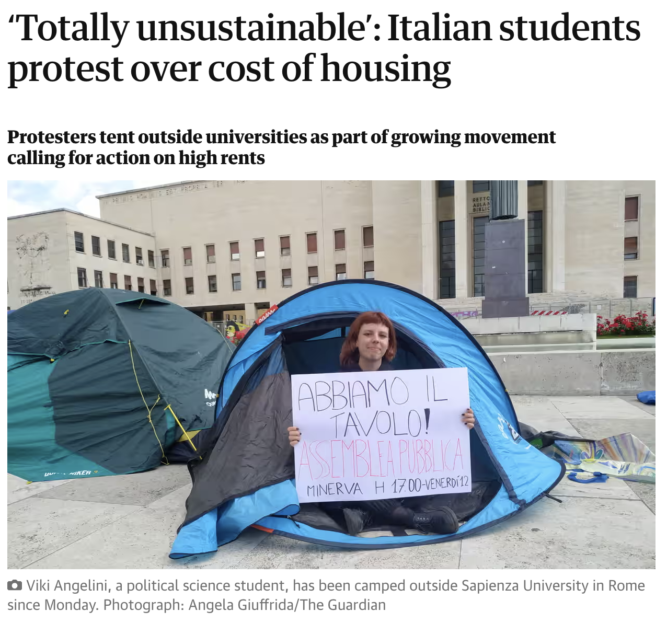
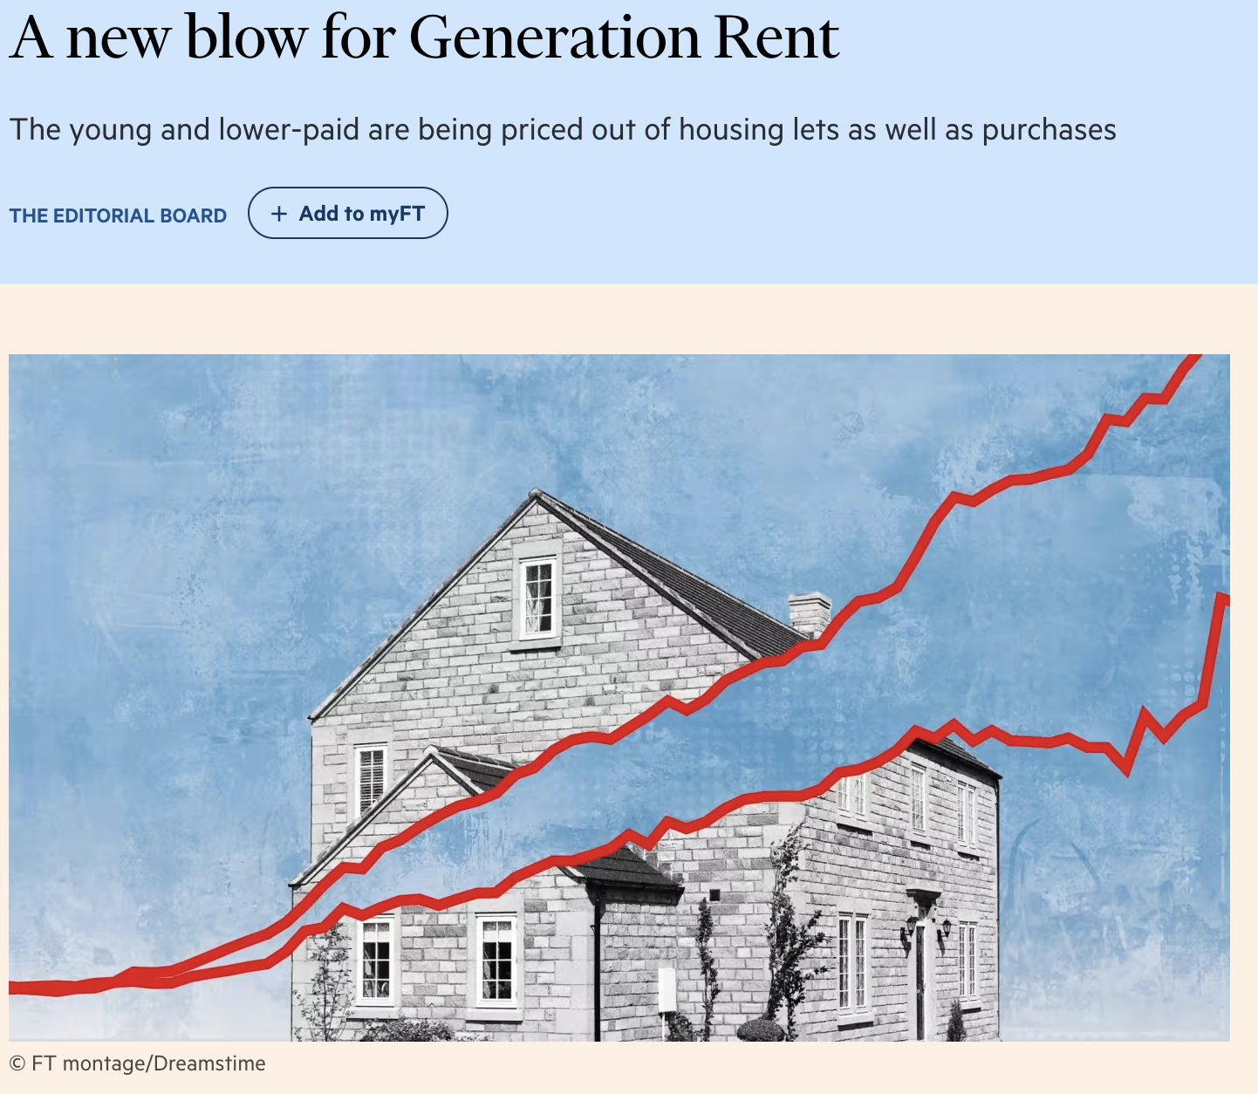


Slide 7
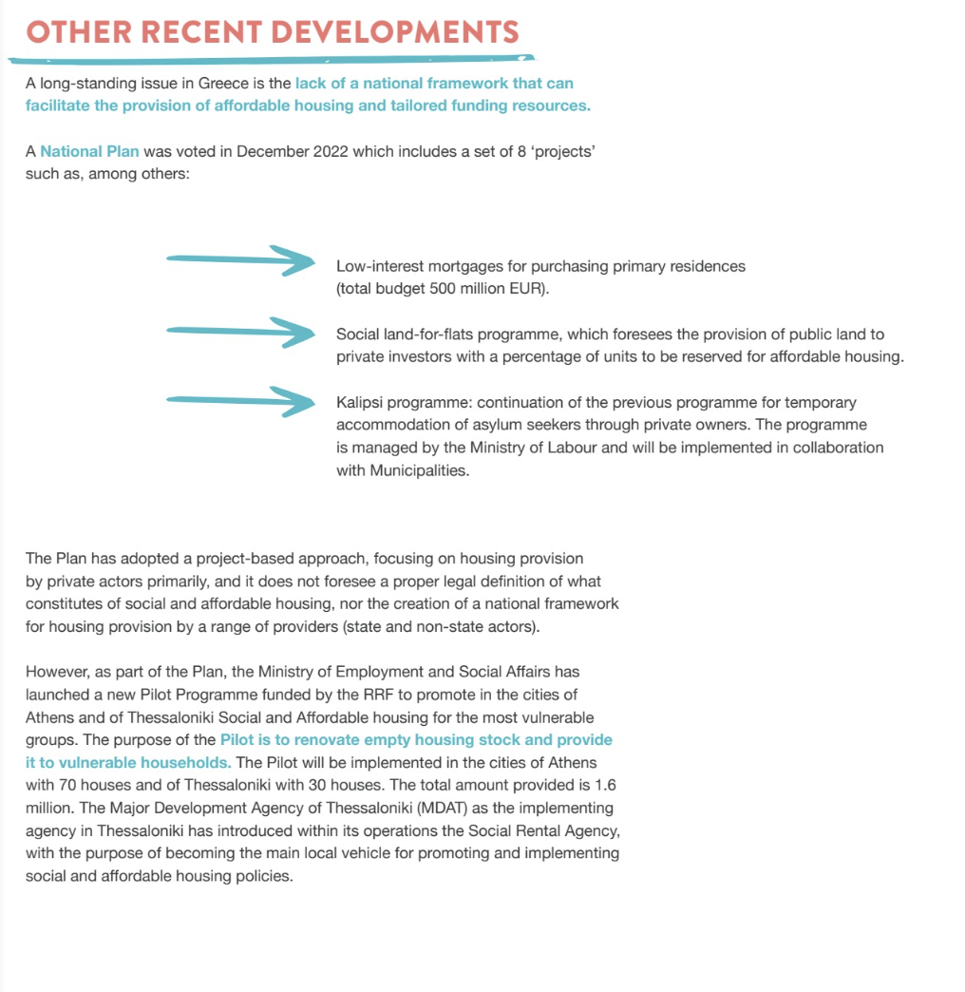
OUR LATEST ‘STATE OF HOUSING IN EUROPE’ REPORT & GREECE
www.stateofhousing.eu

Slide 8
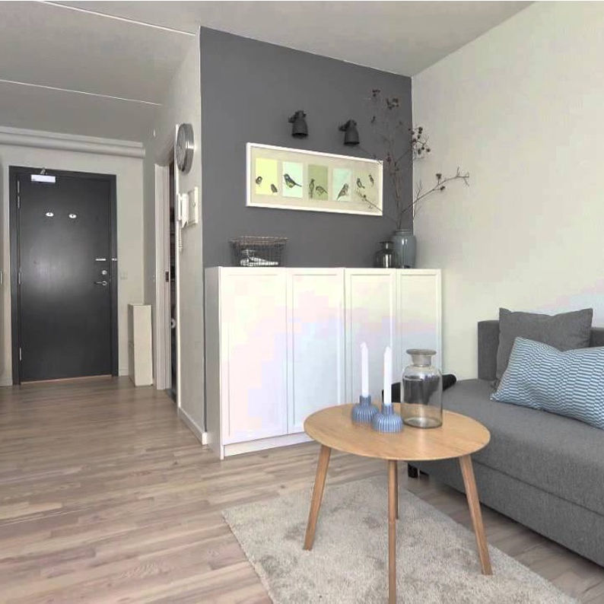
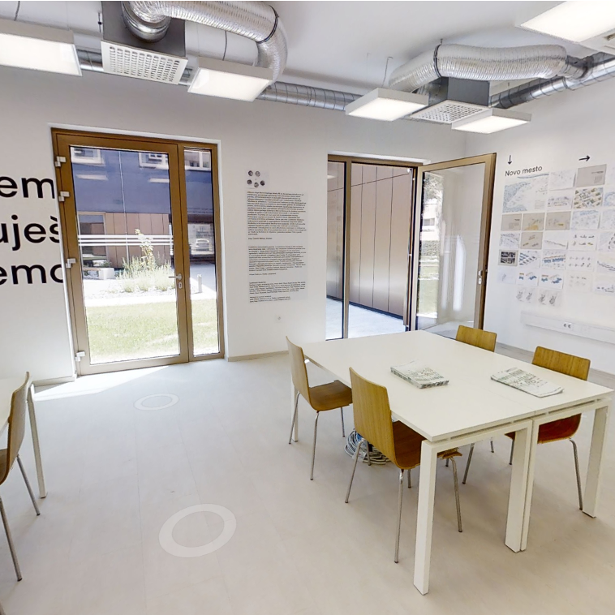

The role of public, cooperative & social housing
DENMARK
SLOVENIA
ITALY
‘Youth’ housing is a dedicated form of non-profit-housing provision
“Youth” housing is a new ambition, never too late
Milano 2035
The Youth Housing Coalition
Students, young workers, tackles youth homelessness
EU youth leaves home at 27
Danes at an age of 21
Housing Fund of the Republic of Slovenia (HFRS) provides financing for the development of affordable housing, targets also youth & offers amenities
22 housing projects, 300 beds for young people (18-35 years old); youth cohousing, intergeneretional homes, public housing

Slide 9
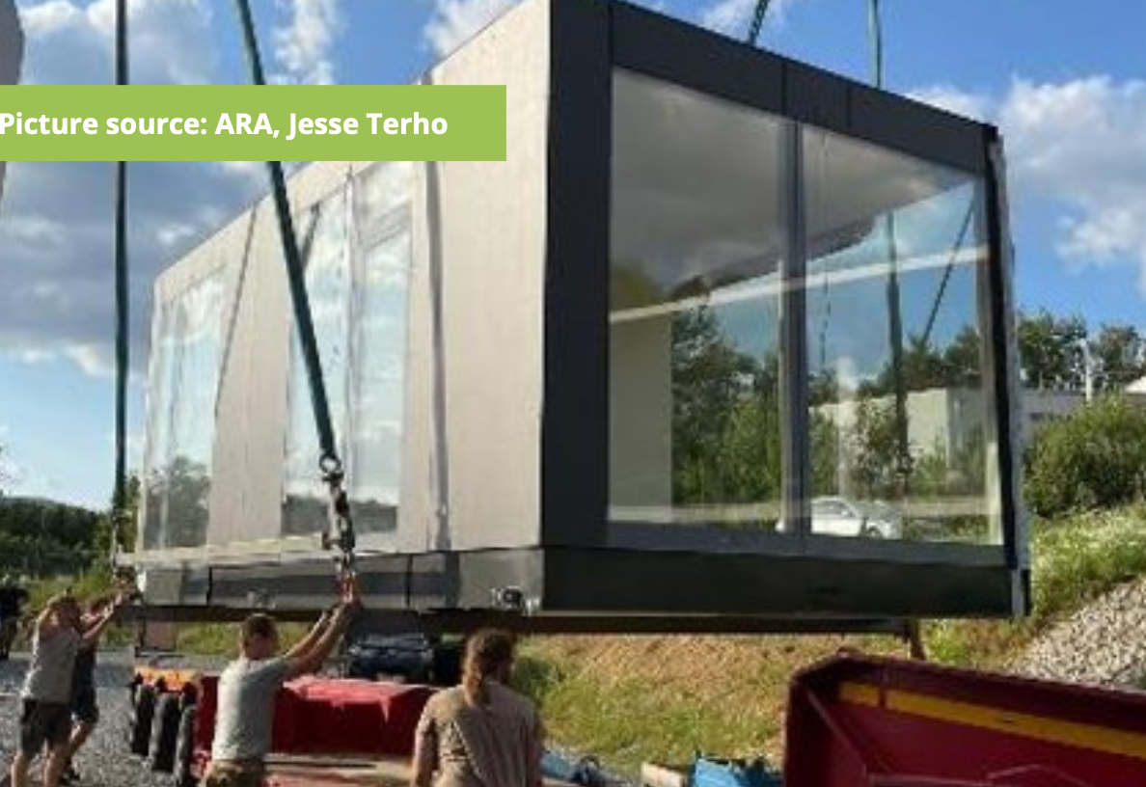

LOOKING AT THE NEEDS OF THE YOUTH
Kiubo, a spinoff of a social housing company in Austria tackles rightsizing of flats
Revival of coops in Lisbon, the city’s plan to lend land to youth for 90 years so that they can build on it
AUSTRIA
PORTUGAL

Slide 10


LOOKING AT THE NEEDS OF THE YOUTH
NAL Assunot, 30+ years of providing social housing only for youth & ahead with all things digital
Parteon & Lieven de Key in the Netherlands run
community projects & raise awareness what happens at 35+
FINLAND
THE NETHERLANDS

Slide 11
The way ahead after the European Year of Youth

Slide 12

OUR CALL
Invest in social, community-led affordable housing
Analyse needs at local level and identify gaps
Guarantee security of tenure at the private rental market
Young people on low incomes need an ‘independence-supporting approach’
Consider the cooperative movement and Community Land Trusts
Implement measures to combat and prevent youth homelessness
Make sure the EU Green Deal is not pricing young people out
Today’s youth will be tomorrow’s owners and tenants

Slide 13


THE POWER OF THE NARRATIVE

Slide 14
THANK YOU
diana.yordanova@housingeurope.eu I @HousingEurope on Twitter LinkedIn Facebook

